Slide 1
ZS Data Science Challenge
Cristian Ronaldo
-Aditya Tiwari

Slide 2
1.Data Preparation
Being a Football DataSet, there are many of insights that can be caught directly from seeing the dataset itself.
It initially contained 28 variables(27 predictors,1 target).
Too many missing values spotted, maybe they’ll be helpful to impute others, so we will gradually treat them.
Only two variables in no missing values: match_id,team_id
There are many of the features must be discarded which holds no significance on scoring a goal, like: Unnamed: 0 and match_event_id

Slide 3
It is clearly observable that location_x,location_y will be redundant as the same information will be carried out by distance_of_shot variable.
Similarily, lat/lng gives information about the venue they are playing on, whose information will be carried out by home/away variable.
These features are better to be dropped out.

Slide 4
1.1 Treating Missing Values:
Since the data is ordered in ascending order of matches, same matches rows are altogether. So, variables like knockout_match, home/away and game/season are imputed according to their adjacent values.
type_of_shot and type_combined_shot seems like two of the most important features have 15k missing values, but they are contradictory to each other. Imputing them with ‘unknown’ to both and review it further.
remaining_min,power_of_shot,knockout_match,remaining_sec,distance_of_shot have duplicate columns present of them. The one having garbage values are removed.

Slide 5
The features ‘area_of_shot’ ,’power_of_shot’, ‘shot_basics’ are imputed by mode as there are quite less missing values in these columns and mode will be the best and straightforwad way to impute them.
Distance_of_shot is dependent upon the shot_basics, so imputed according to shot_basics feature
Range_of_shot and distance_of_shot, both will be highly correlated and distance_of_shot has already been imputed meaningfully, so range_of_shot will be dropped

Slide 6
There were no outliers to be removed from the data, it could have been done but the test set may suffer from it and it would not have made a noticeable difference.

Slide 7
2.Exploratory Data Analysis
Chi-Square test: 'knockout_match','home/away','match_id','power_of_shot‘ showed to be the irrelevant features have p-value>0.05 again our targer ‘is_goal’ variable.

Slide 8
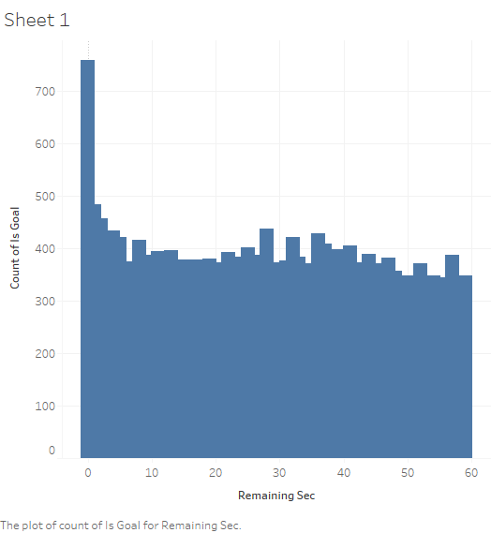
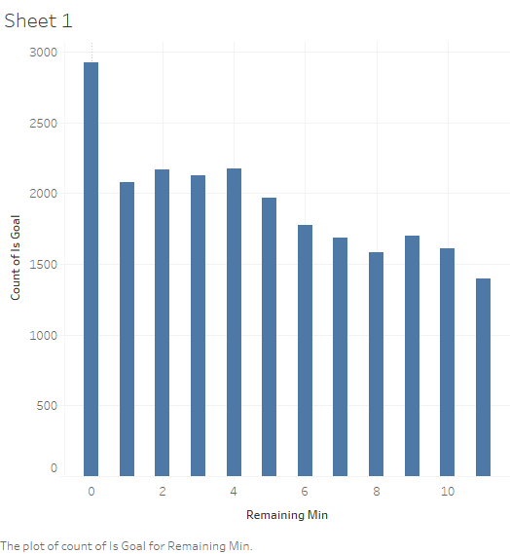
As shown in the figure, remaining_min shows gradually increments as it shift towards lesser minutes while remaining_sec shows uniform distribution.
Remaining_sec will be a redundant feature for the model

Slide 9
Handling Features
As only two numeric variables are lest for the model, we will scale them using MinMaxScaler(), which is very helpful in increasing performance of non-tree based models.
Using get_dummies() to create dummies of the categorical variables which will certainly help non-tree based models.

Slide 10
3. Model building
Logistic regression is a powerful statistical way of modeling a binomial outcome and plus the way data is pre-processed looks like for logistic regression.
Logistic Regression is the appropriate regression analysis to conduct when the dependent variable is dichotomous (binary). Like all regression analyses, the logistic regression is a predictive analysis. Logistic regression is used to describe data and to explain the relationship between one dependent binary variable and one or more independent variables. also, data is scaled which is expected good for a linear model.
Therefore, I used Logistic regression as my first go.

Slide 11
For model evaluation, I calculated MAPE for Logistic Regression, SVM and Naïve Bayes.
Logistic Regression performed the best

